Slide 1
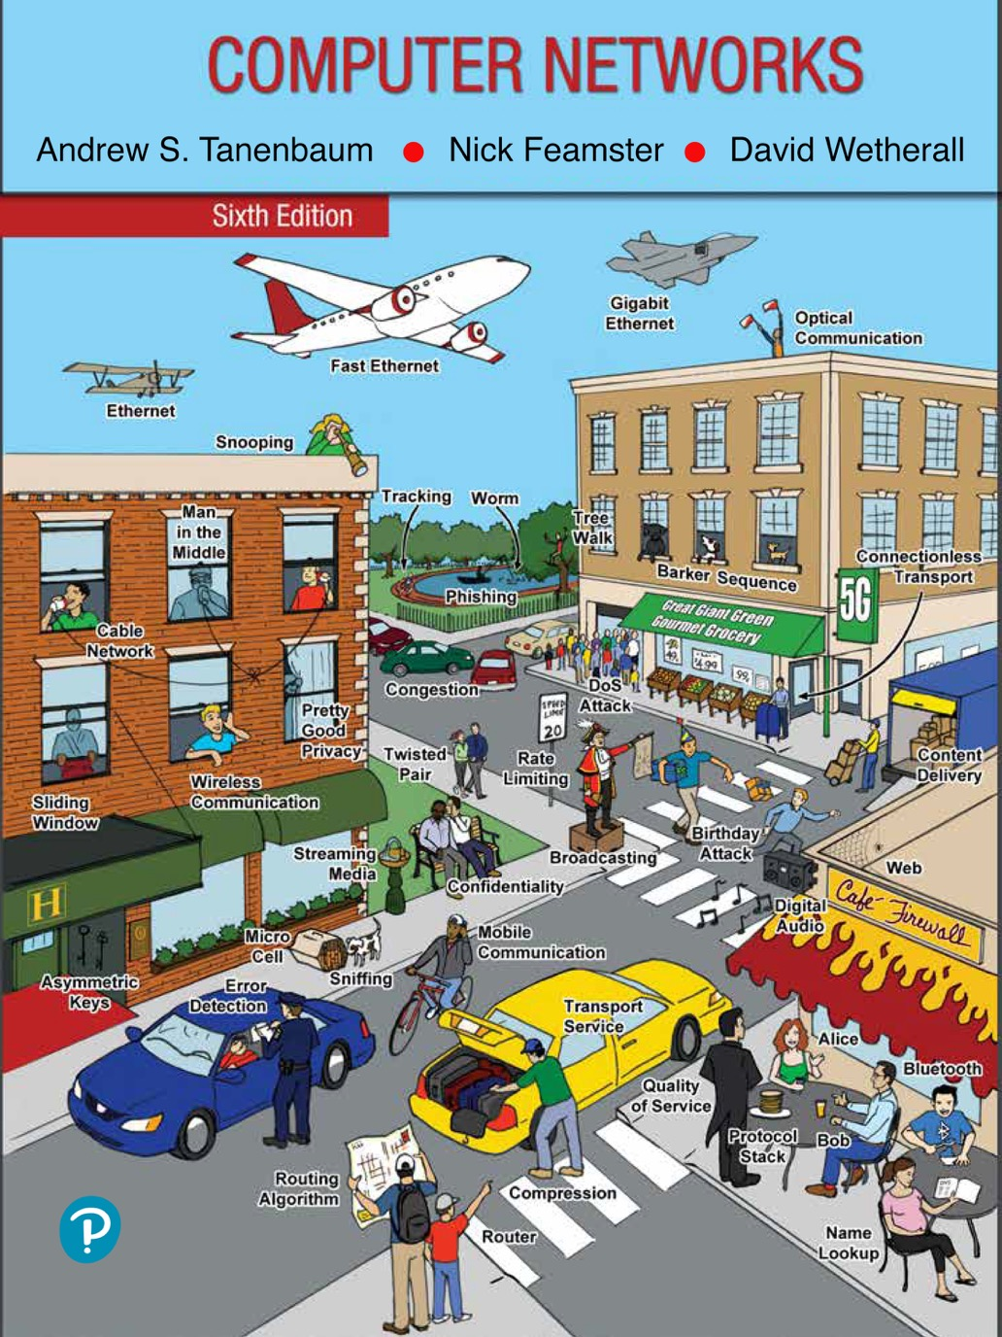
Chapter 4
The Medium Access Control Sublayer

Slide 2
The Channel Allocation Problem
Static channel allocation
Assumptions for dynamic channel allocation

Slide 3
Static Channel Allocation
Static allocation
Poor fit to computer systems with extremely bursty data traffic
Performance affected when peak traffic to mean traffic ratios are 1000:1
Most channels will be idle most of the time
Dynamic allocation tries to resolve static allocation problems

Slide 4
Assumptions for Dynamic Channel Allocation
Independent traffic
Single channel
Observable collisions
Continuous or slotted time
Carrier sense or no carrier sense

Slide 5
Multiple Access Protocols
ALOHA
Carrier Sense Multiple Access
Collision-free protocols
Limited-contention protocols
Wireless LAN protocols

Slide 6
ALOHA (1 of 4)
Pure ALOHA
Slotted ALOHA

Slide 7
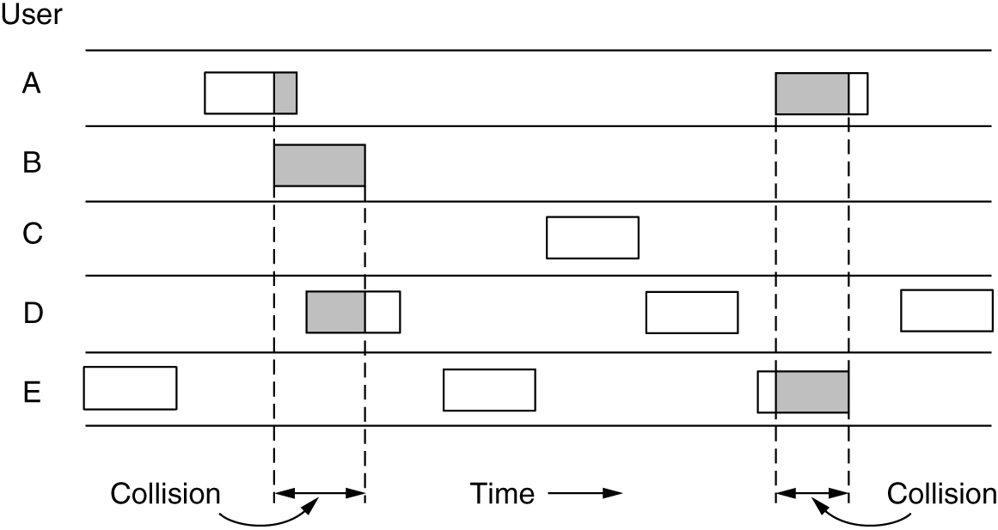
ALOHA (2 of 4)
In pure ALOHA, frames are transmitted at completely arbitrary times.

Slide 8
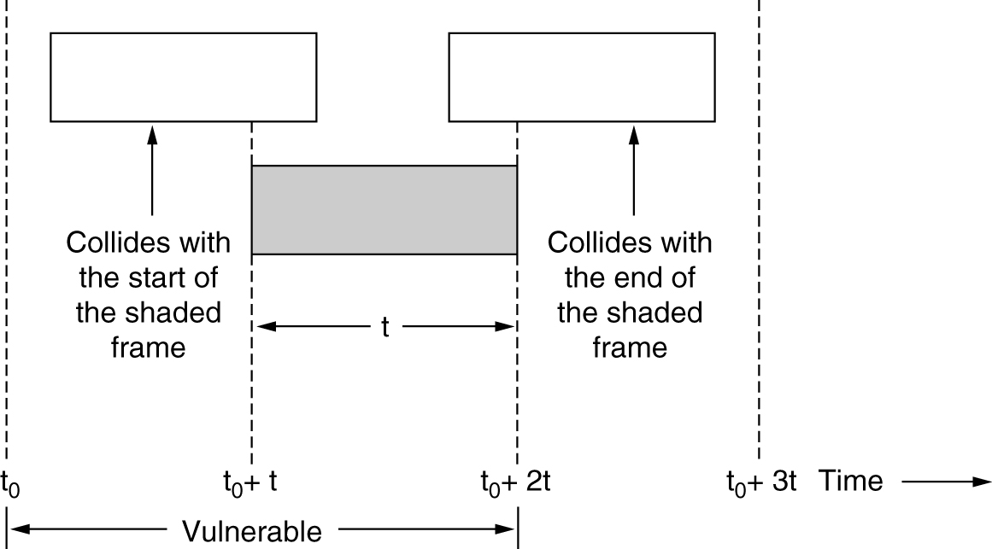
ALOHA (3 of 4)
Vulnerable period for the shaded frame

Slide 9
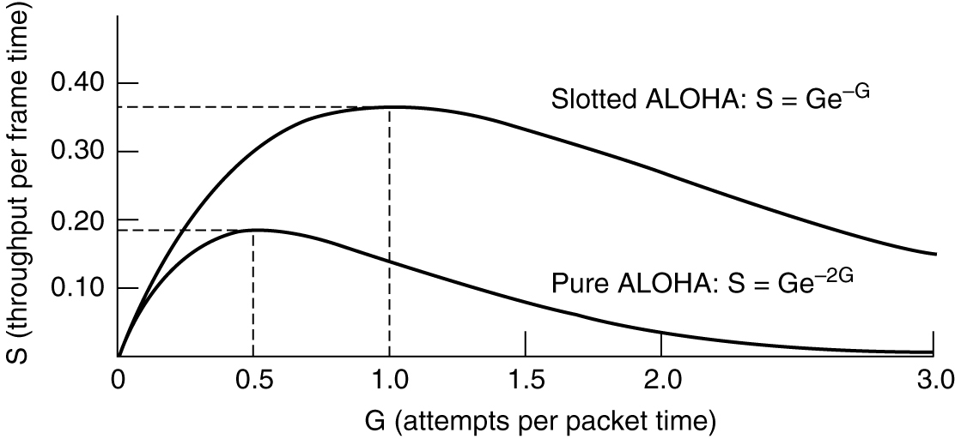
ALOHA (4 of 4)
Throughput versus offered traffic for ALOHA systems

Slide 10
Carrier Sense Multiple Access Protocols
Persistent and nonpersistent CSMA
1-persistent CSMA (Carrier Sense Multiple Access)
Nonpersistent CSMA
p-persistent CSMA
CSMA with collision detection
Known as CSMA/CD (CSMA with Collision Detection)
Basis of the classic Ethernet LAN

Slide 11
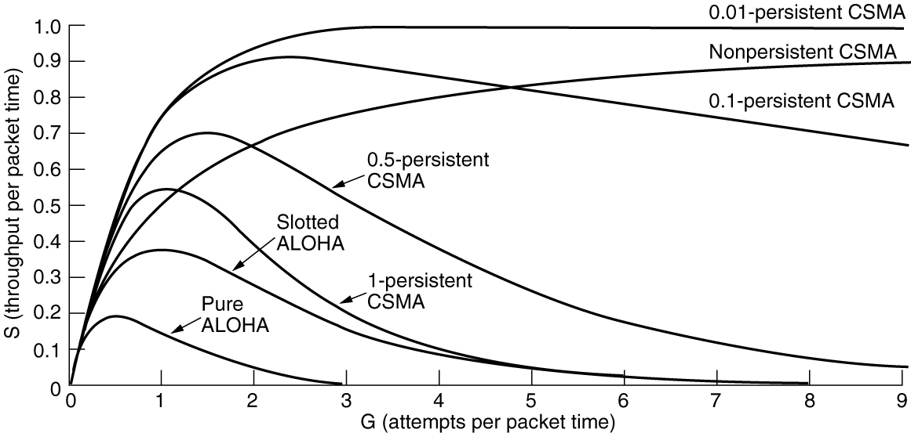
Persistent and Nonpersistent CSMA
Comparison of the channel utilization versus load for various random access protocols

Slide 12
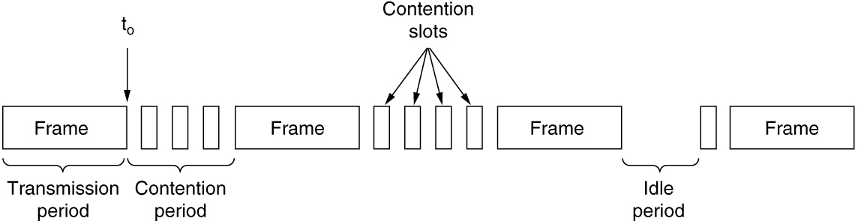
CSMA with Collision Detection
CSMA/CD can be in transmission, contention, or idle state

Slide 13
Collision-Free Protocols
Bit-map protocol
Basic bit-map method
Reservation protocols
The desire to transmit is broadcast before the actual transmission
Token passing
Token bus
FDDI (Fiber Distributed Data Interface)
RPR (Resilient Packet Ring)
Defined as IEEE 802.17 to standardize the mix of metropolitan area rings in use by ISPs
Binary countdown

Slide 14
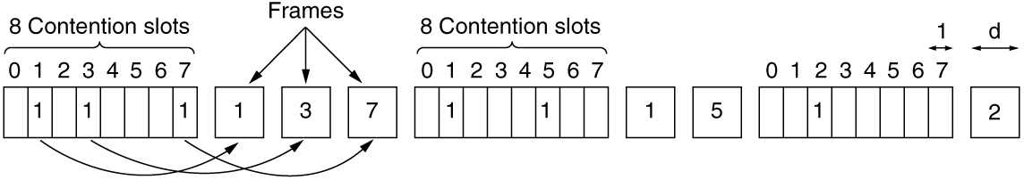
A Bit-Map Protocol
The basic bit-map protocol

Slide 15
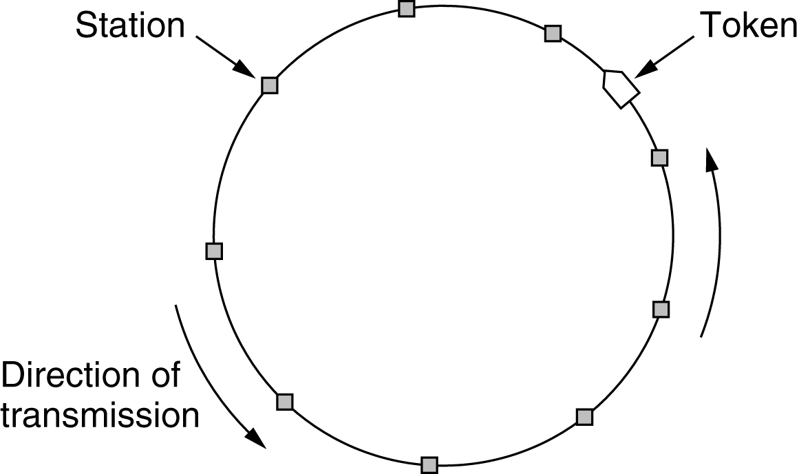
Token Passing
Token ring

Slide 16
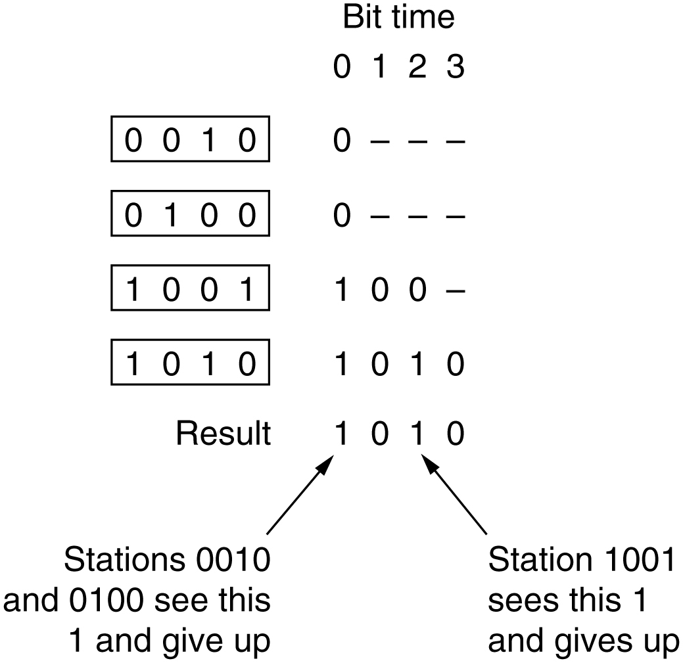
Binary Countdown
The binary countdown protocol. A dash indicates silence.

Slide 17
Limited-Contention Protocols (1 of 2)
Combines the best properties of the contention and collision-free protocols
Limited-contention protocol
Use contention at low load to provide low delay
Used a collision-free technique at high load to provide good channel efficiency
Asymmetric protocols
Review performance of the symmetric protocols first
The adaptive tree-walk protocol

Slide 18
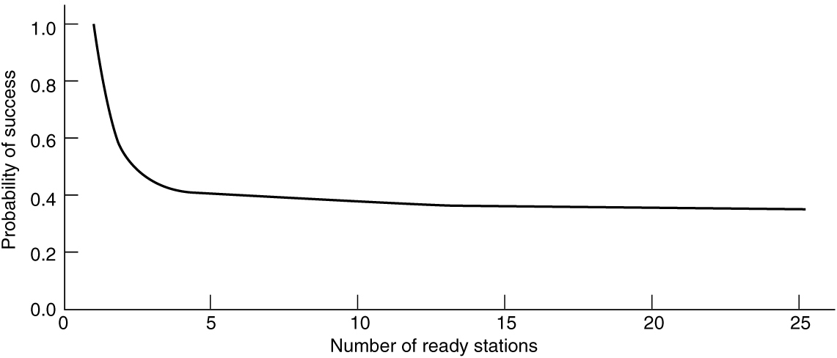
Limited-Contention Protocols (2 of 2)
Acquisition probability for a symmetric contention channel

Slide 19
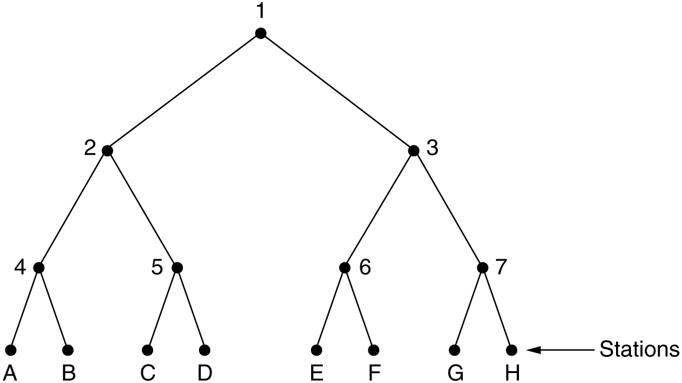
The Adaptive Tree-Walk Protocol
The tree for eight stations

Slide 20
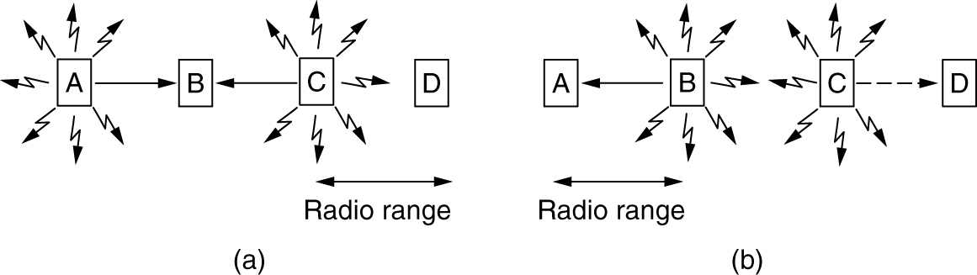
Wireless LAN Protocols (1 of 2)
A wireless LAN. (a) A and C are hidden terminals when transmitting to B. (b) B and C are exposed terminals when transmitting to A and D.

Slide 21
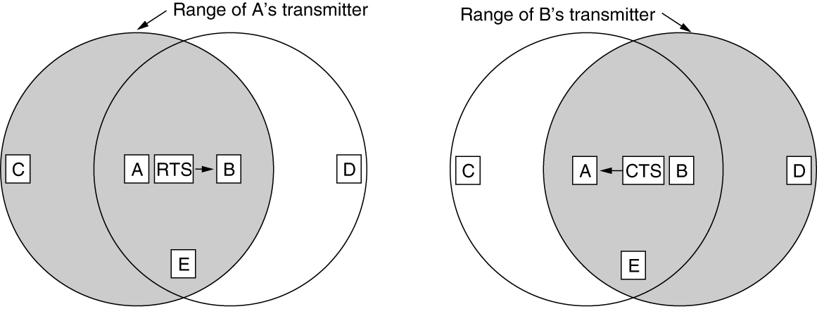
Wireless LAN Protocols (2 of 2)
The MACA protocol. (a) A sending an RTS to B. (b) B responding with a CTS to A.

Slide 22
Ethernet (1 of 2)
Classic Ethernet physical layer
Classic Ethernet MAC sublayer protocol
CSMA/CD with binary exponential backoff
Ethernet performance
Switched Ethernet
Fast Ethernet

Slide 23
Ethernet (2 of 2)
Gigabit Ethernet
10-Gigabit Ethernet
40- and 100-Gigabit Ethernet
Retrospective on Ethernet

Slide 24
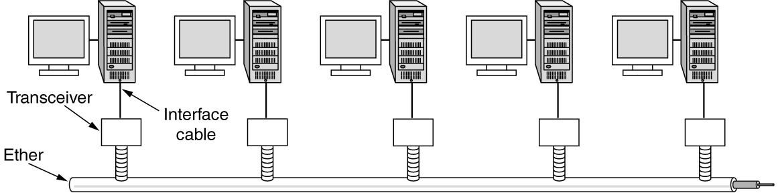
Classic Ethernet Physical Layer
Architecture of classic Ethernet

Slide 25
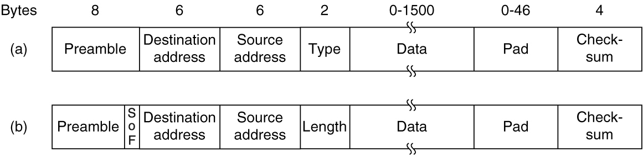
Classic Ethernet MAC Sublayer Protocol (1 of 2)
Frame formats. (a) Ethernet (DIX). (b) IEEE 802.3.

Slide 26
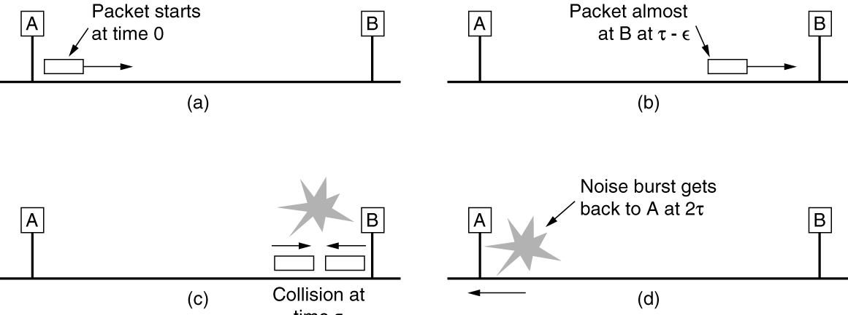
Classic Ethernet MAC Sublayer Protocol (2 of 2)
Collision detection can take as long as 2t.

Slide 27
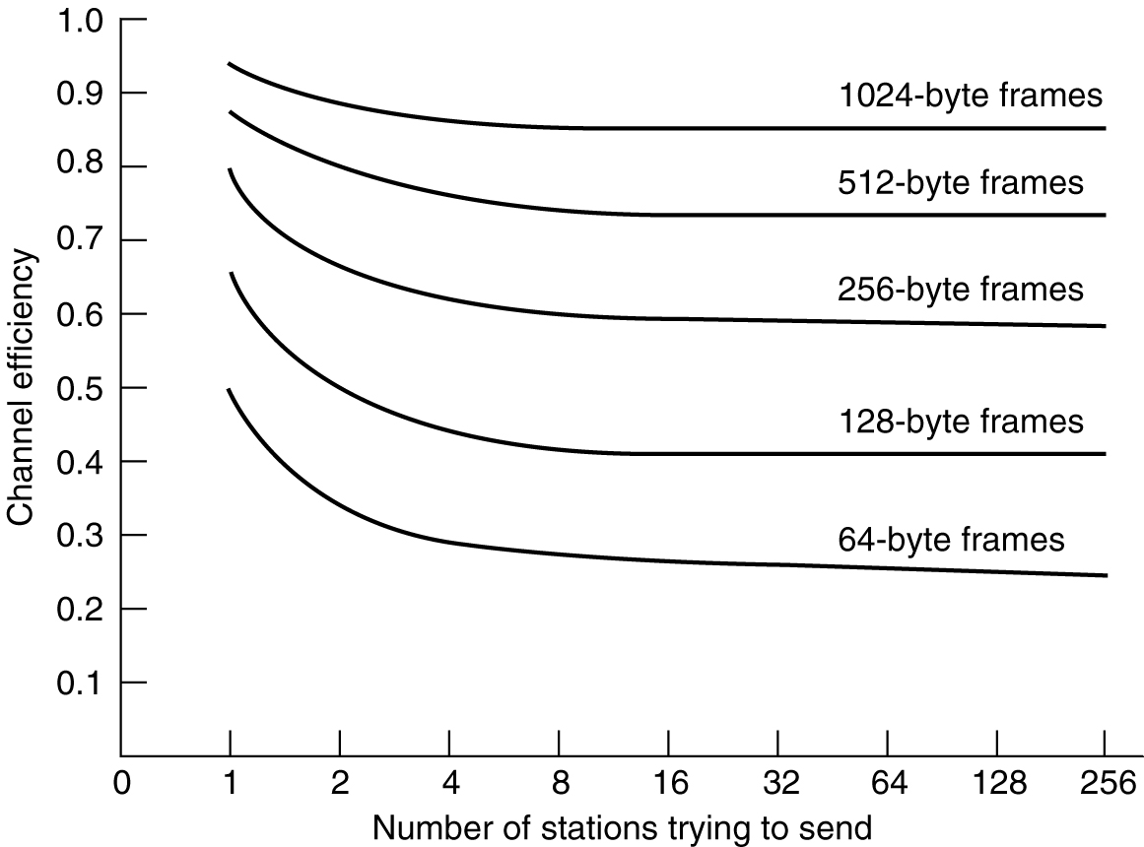
Ethernet Performance
Efficiency of Ethernet at 10 Mbps with 512-bit slot times

Slide 28
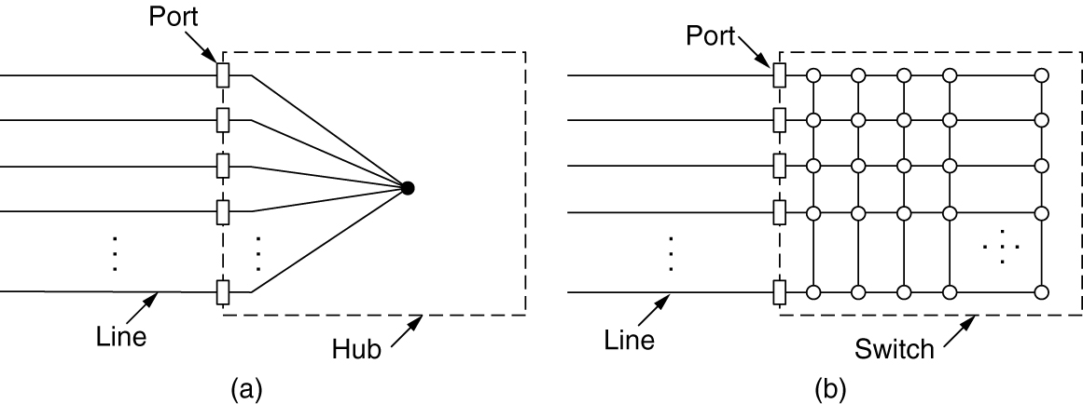
Switched Ethernet (1 of 2)
(a) Hub. (b) Switch.

Slide 29
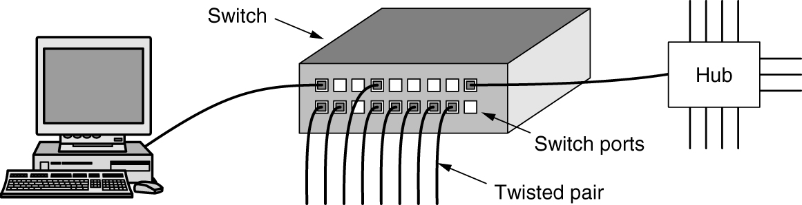
Switched Ethernet (2 of 2)
An Ethernet switch

Slide 30
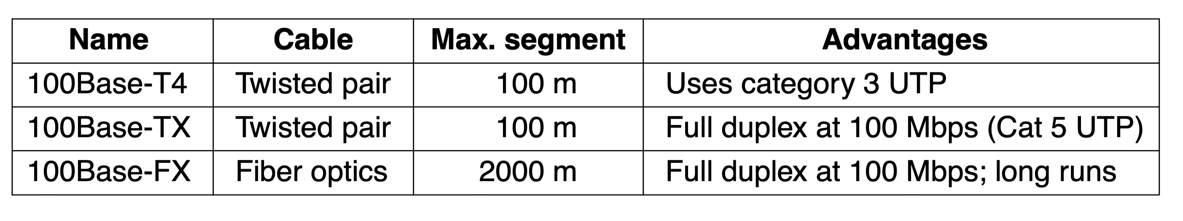
Fast Ethernet
The original fast Ethernet cabling

Slide 31
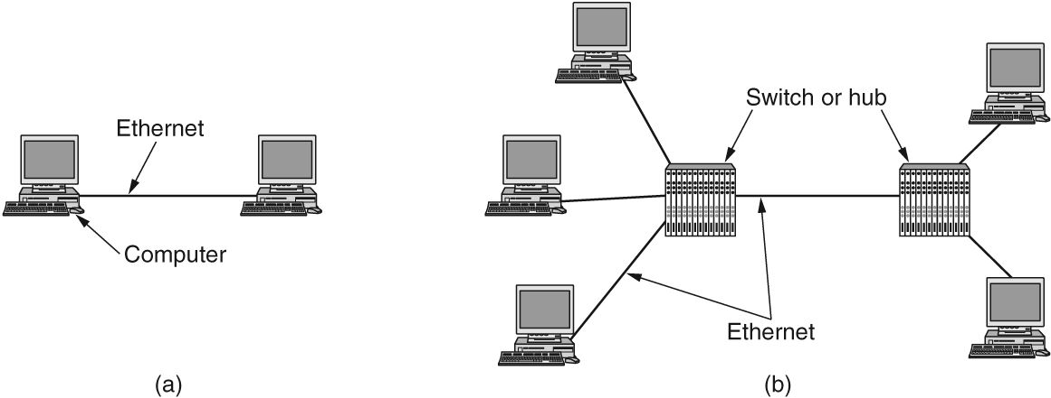
Gigabit Ethernet (1 of 2)
(a) A two-station Ethernet. (b) A multistation Ethernet.

Slide 32
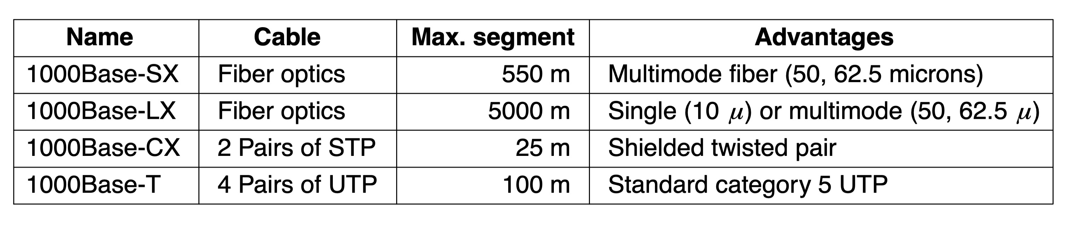
Gigabit Ethernet (2 of 2)
Gigabit Ethernet cabling

Slide 33
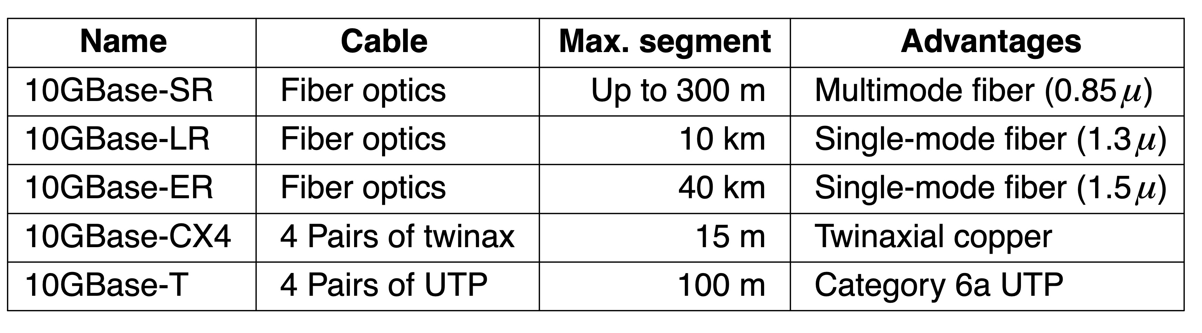
10-Gigabit Ethernet
10-Gigabit Ethernet cabling

Slide 34
Wireless LANs
802.11 architecture and protocol stack
802.11 physical layer
802.11 MAC sublayer protocol
802.11 frame structure
Services

Slide 35
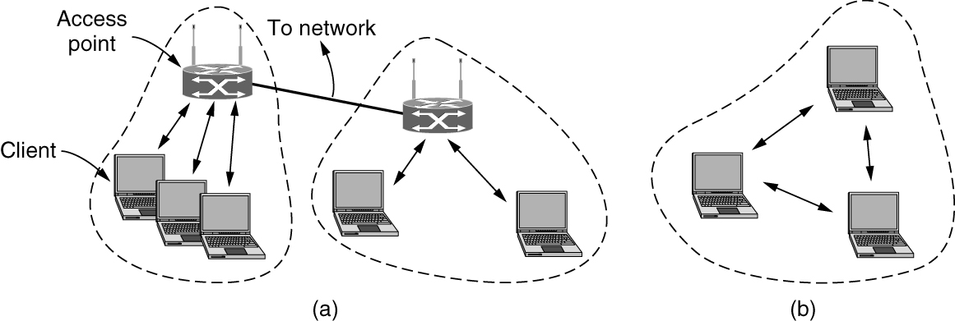
The 802.11 Architecture and Protocol Stack (1 of 2)
802.11 architecture. (a) Infrastructure mode. (b) Ad-hoc mode.

Slide 36
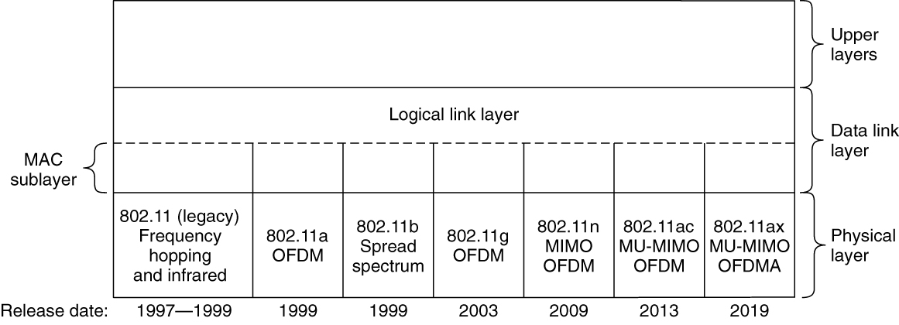
The 802.11 Architecture and Protocol Stack (2 of 2)
Part of the 802.11 protocol stack

Slide 37
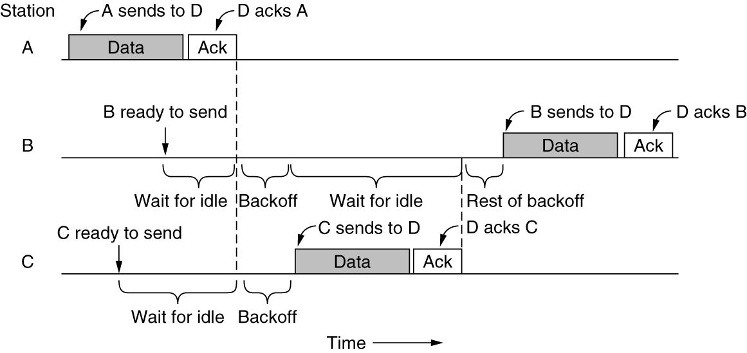
The 802.11 MAC Sublayer Protocol (1 of 4)
Sending a frame with CSMA/CA

Slide 38
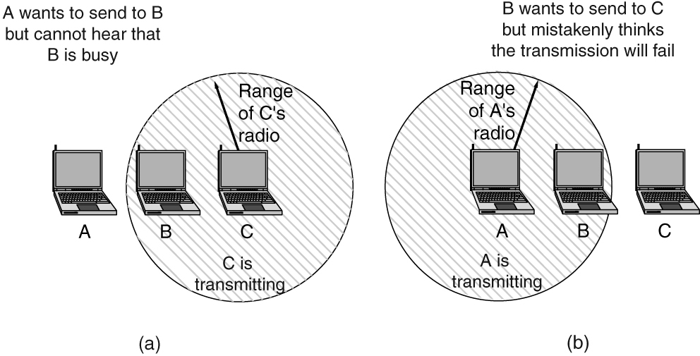
The 802.11 MAC Sublayer Protocol (2 of 4)
(a) The hidden terminal problem. (b) The exposed terminal problem.

Slide 39
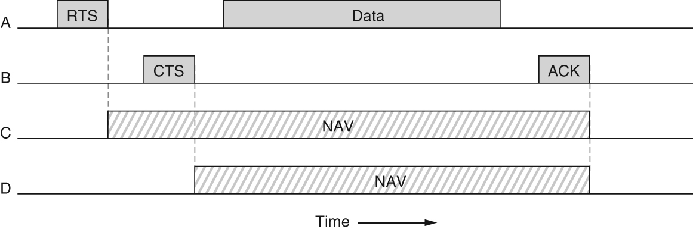
The 802.11 MAC Sublayer Protocol (3 of 4)
Virtual channel sensing using CSMA/CA

Slide 40
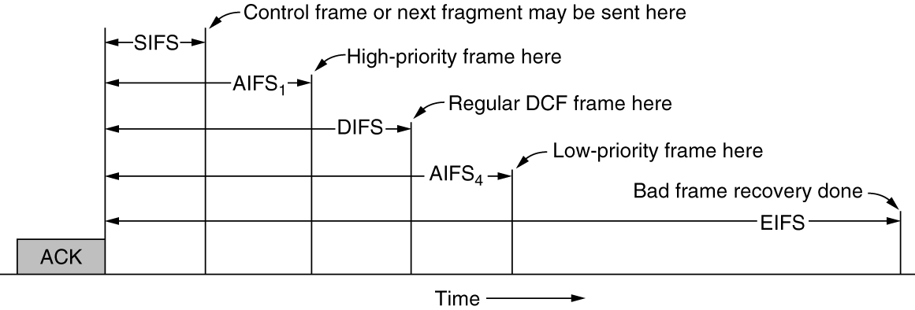
The 802.11 MAC Sublayer Protocol (4 of 4)
Interframe spacing in 802.11

Slide 41
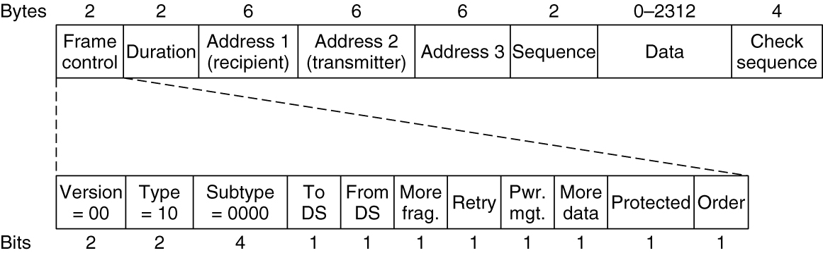
The 802.11 Frame Structure
Format of the 802.11 data frame

Slide 42
Services
Association and data delivery
Security and privacy
Prioritization and power control

Slide 43
Bluetooth
Bluetooth architecture
Bluetooth applications
Bluetooth protocol stack
Bluetooth radio layer
Bluetooth link layers
Bluetooth frame structure
Bluetooth 5

Slide 44
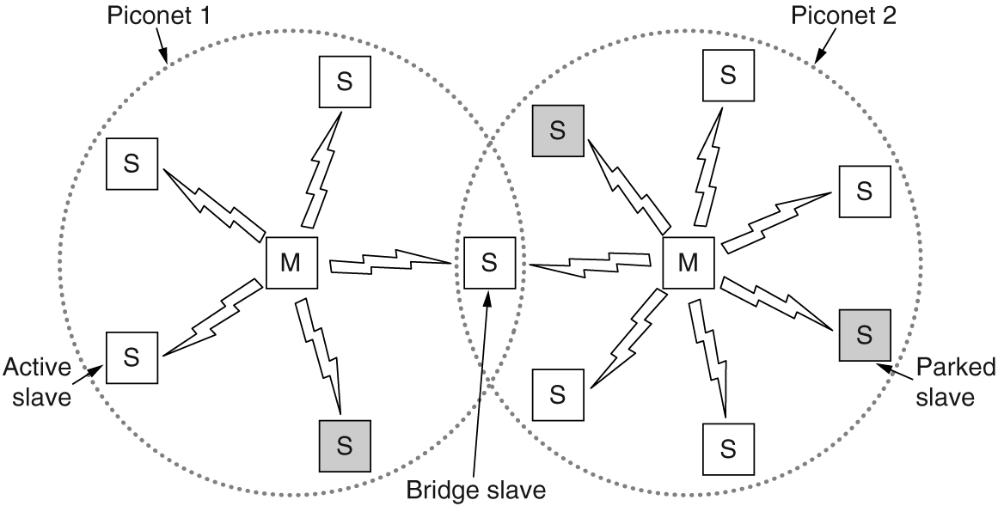
Bluetooth Architecture
Two piconets can be connected to form a scatternet

Slide 45
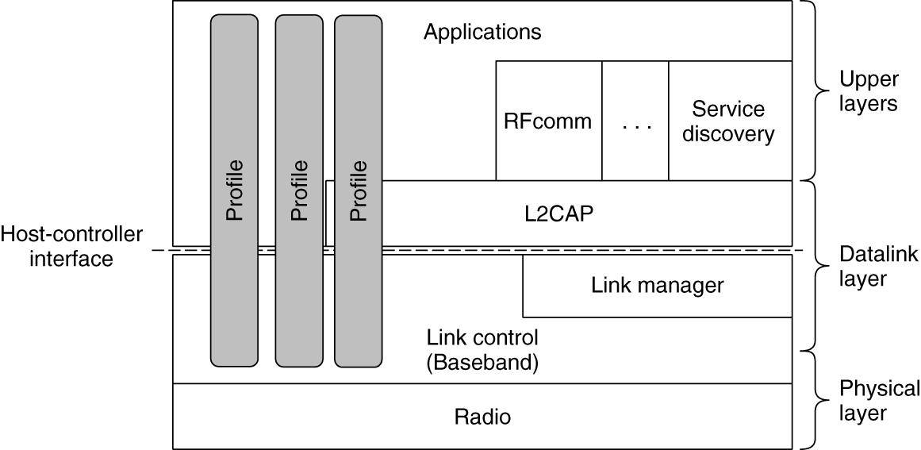
The Bluetooth Protocol Stack
The Bluetooth protocol architecture

Slide 46
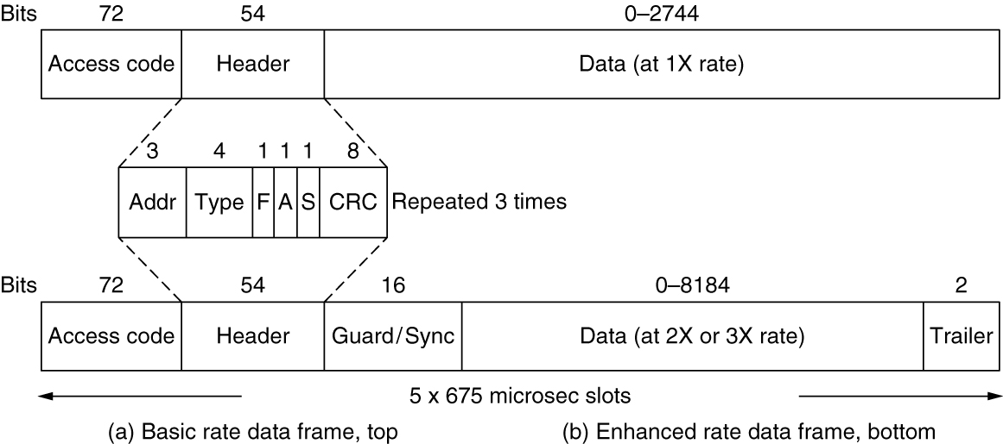
The Bluetooth Frame Structure
Typical Bluetooth data frame at (a) basic and (b) enhanced data rates.

Slide 47
Bluetooth 5
Support for Internet of Things devices
Speed increased from 1 Mbps to 2 Mbps
Message size has gone up from 31 bytes to 255 bytes
Range indoors has gone up from 10 m to 40 m
Power requirements have been reduced slightly
Range of the beacons has gone up slightly
Slightly better security

Slide 48
DOCSIS
Overview
MAC sublayer performs channel allocation, configuration of quality of service, unique forwarding model
Uses a standard MAC frame format
Ranging
Cable modem transmits a ranging request
CMTS (headend) determines the network delay to the cable modem and performs necessary power adjustment
Channel bandwidth allocation
Service flows
Request-grant process and low-latency DOCSIS

Slide 49
Data Link Layer Switching
Uses of bridges
Learning bridges
Spanning tree bridges
Repeaters, hubs, bridges, switches, routers, and gateways
Virtual LANs
The IEEE 802.1Q standard

Slide 50
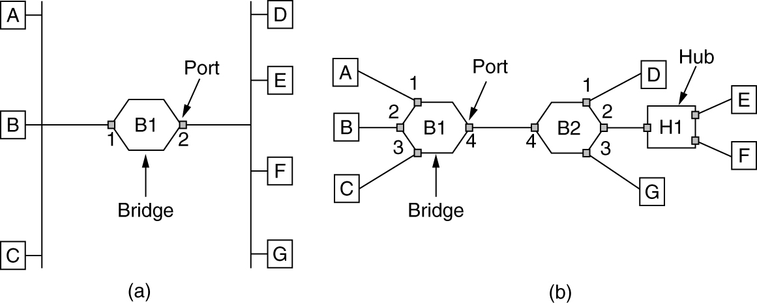
Learning Bridges (1 of 2)
(a) Bridge connecting two multidrop LANs. (b) Bridges (and a hub) connecting seven point-to-point stations.

Slide 51
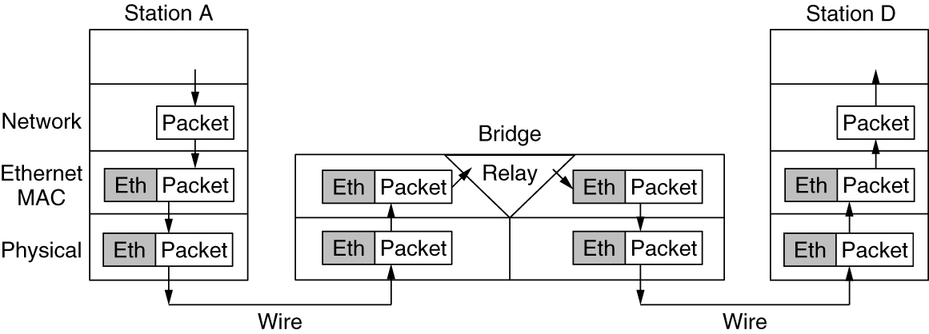
Learning Bridges (2 of 2)
Protocol processing at a bridge

Slide 52
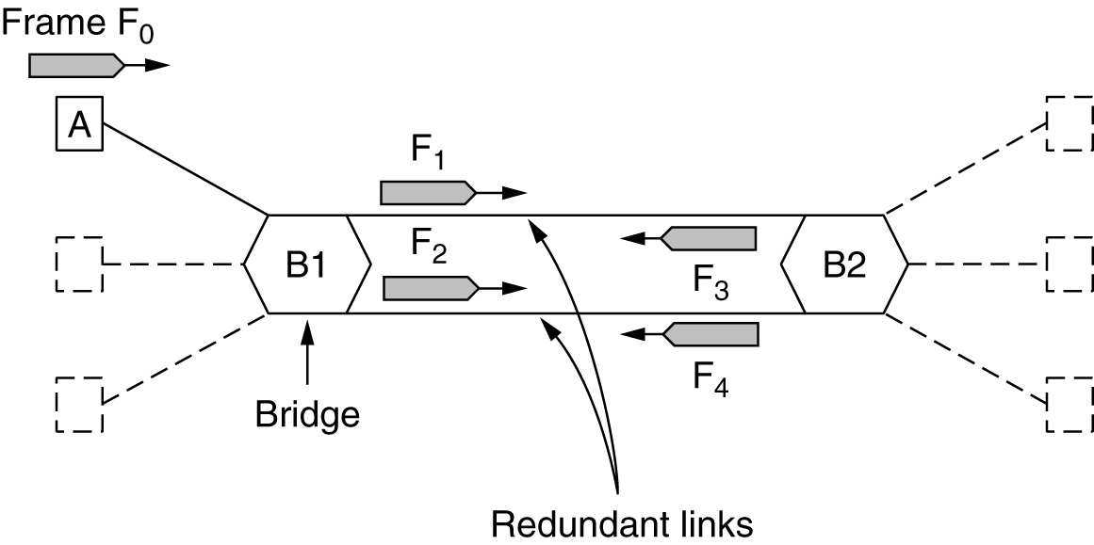
Spanning-Tree Bridges (1 of 4)
Bridges with two parallel links

Slide 53
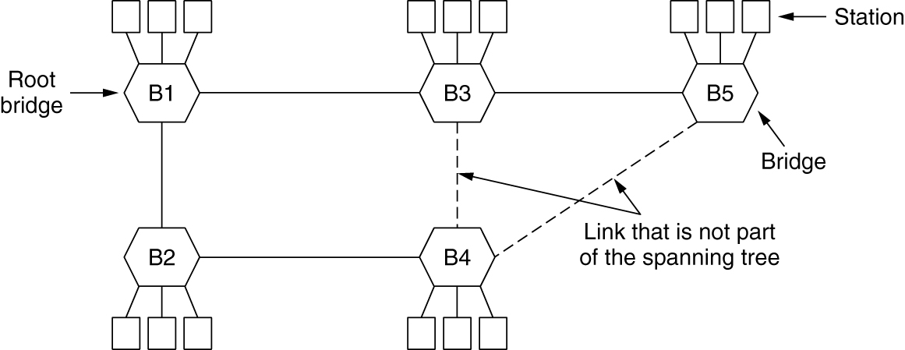
Spanning-Tree Bridges (2 of 4)
A spanning tree connecting five bridges. The dashed lines are links that are not part of the spanning tree.

Slide 54
Spanning-Tree Bridges (3 of 4)
I think that I shall never see
A graph more lovely than a tree.
A tree whose crucial property Is loop-free connectivity.
A tree which must be sure to span.
So packets can reach every LAN.

Slide 55
Spanning-Tree Bridges (4 of 4)
First the Root must be selected
By ID it is elected.
Least-cost paths from Root are traced
In the tree these paths are placed.
A mesh is made by folks like me
Then bridges find a spanning tree.
-- Radia Perlman

Slide 56
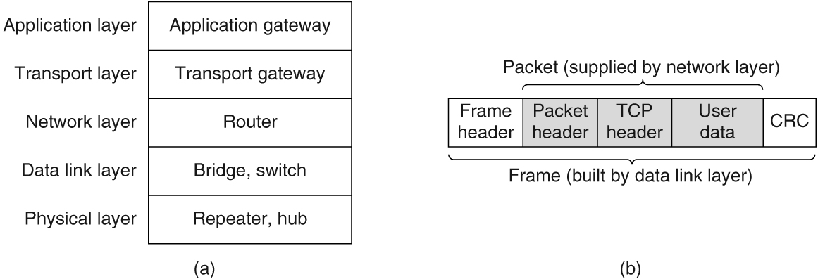
Repeaters, Hubs, Bridges, Switches, Routers, and Gateways
(a) Which device is in which layer. (b) Frames, packets, and headers.

Slide 57
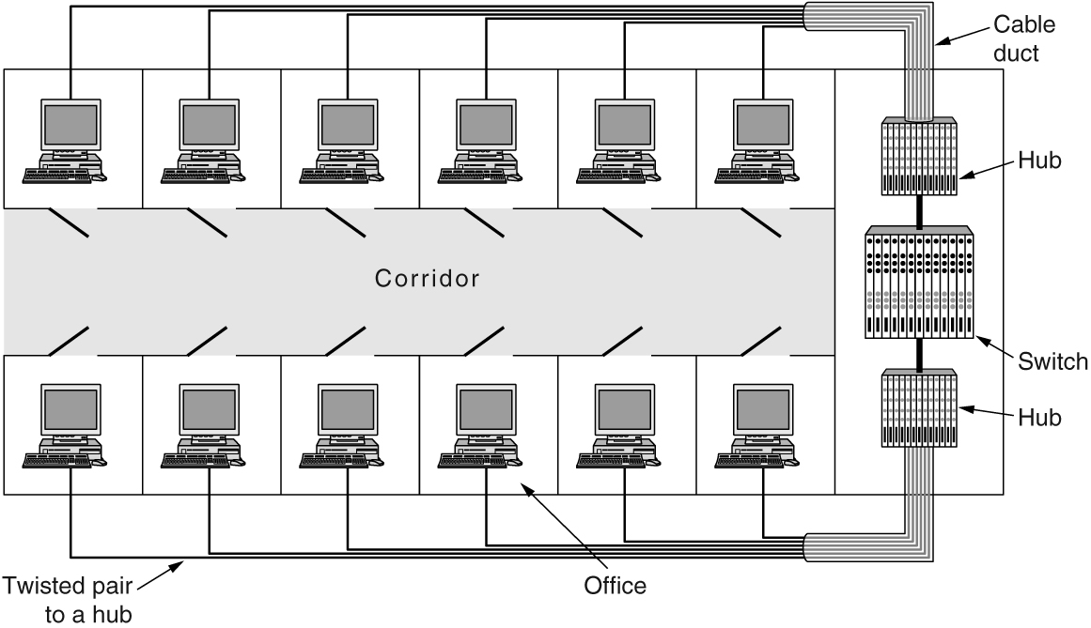
Virtual LANs (1 of 2)
A building with centralized wiring using hubs and a switch

Slide 58
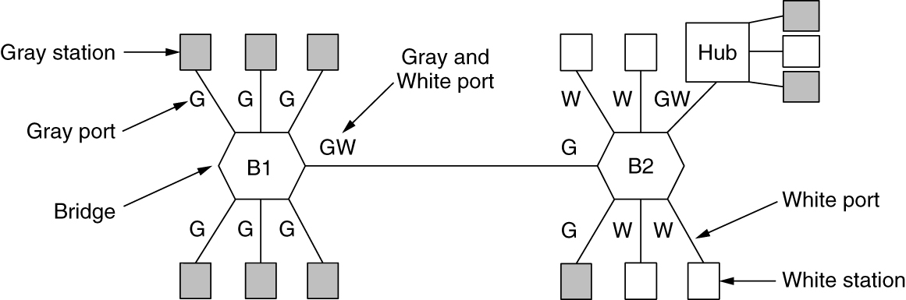
Virtual LANs (2 of 2)
Two VLANs, gray and white, on a bridged LAN

Slide 59
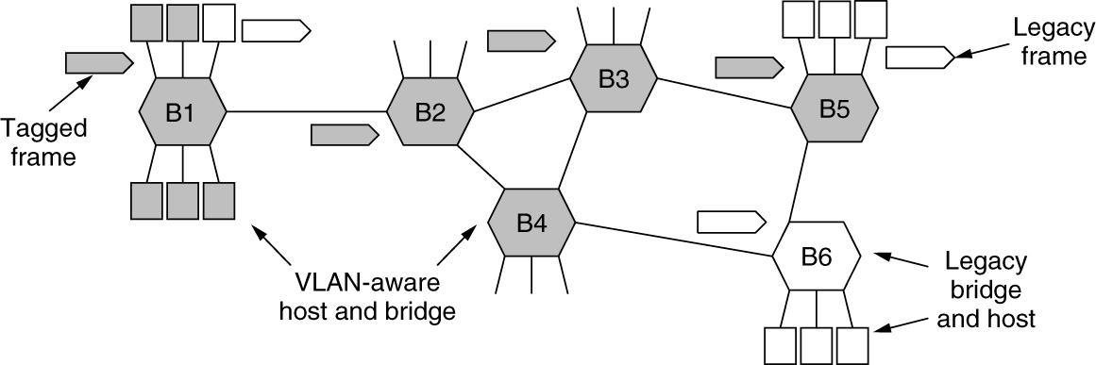
The IEEE 802.1Q Standard (1 of 2)
Bridged LAN that is only partly VLAN aware. The shaded symbols are VLAN aware. The empty ones are not.

Slide 60
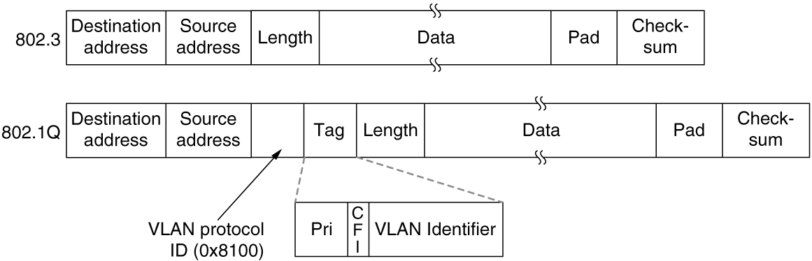
The IEEE 802.1Q Standard (2 of 2)
The 802.3 (legacy) and 802.1Q Ethernet frame formats

Slide 61

Copyright
This work is protected by United States copyright laws and is provided solely for the use of instructors in teaching their courses and assessing student learning. Dissemination or sale of any part of this work (including on the World Wide Web) will destroy the integrity of the work and is not permitted. The work and materials from it should never be made available to students except by instructors using the accompanying text in their classes. All recipients of this work are expected to abide by these restrictions and to honor the intended pedagogical purposes and the needs of other instructors who rely on these materials.

